Slide 1
Course Code: 20PDS2109 Course Title: Advance Web Technology
Faculty Name : Dr. V. Arul Kumar

Slide 2
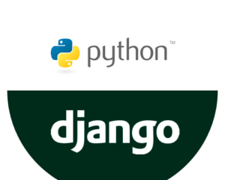
Advance Web Technology

Slide 3
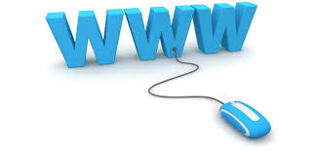
Introduction
What is a WEB?
The Web is the common name for the World Wide Web

Slide 4
Introduction
What is World Wide Web?
It is an information system where documents and other web resources are identified by Uniform Resource Locators (URLs, such as https://example.com/), which may be interlinked by hypertext, and are accessible over the Internet.

Slide 5
Introduction
What is Client Server Computing?
In client server computing,
The clients requests a resource and the server provides that resource.
A server may serve multiple clients at the same time while a client is in contact with only one server.
Both the client and server usually communicate via a computer network but sometimes they may reside in the same system.

Slide 6
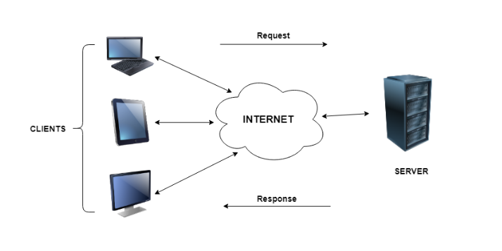
Introduction
Client Server Computing

Slide 7
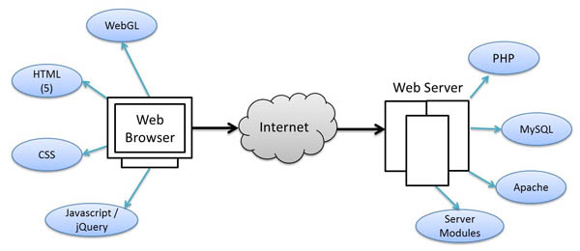
Introduction
What is a Web Technology?
Web technologies are the various tools and techniques that are utilised in the process of communication between different types of devices over the internet.

Slide 8
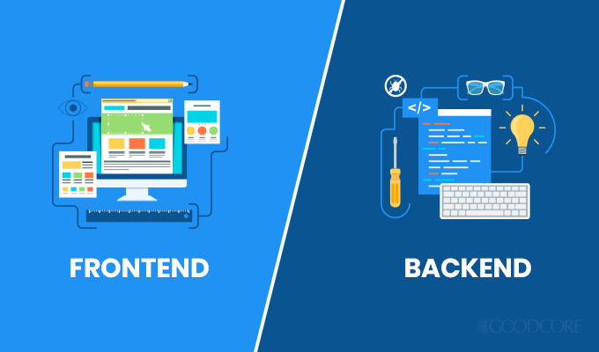
Introduction
What is a Web Development?
Web development refers to the process of creating websites.
The two parts of a typical website

Slide 9
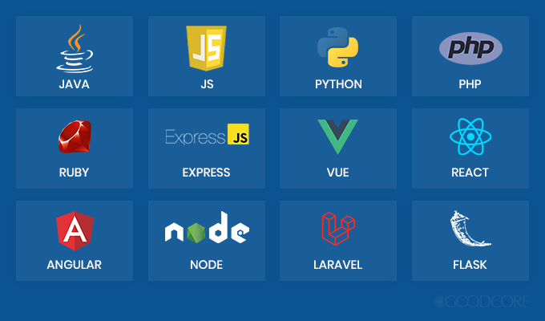
Introduction
Programming Languages And Frameworks

Slide 10
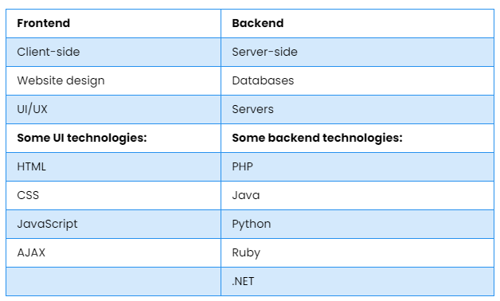
Introduction
Frontend and Backend

Slide 11
Introduction
What is MVC Architecture?
Model View Controller or MVC as it is popularly called, is a software design pattern for developing web applications.
A Model View Controller pattern is made up of the following three parts
Model − The lowest level of the pattern which is responsible for maintaining data.
View − This is responsible for displaying all or a portion of the data to the user.
Controller − Software Code that controls the interactions between the Model and View.

Slide 12
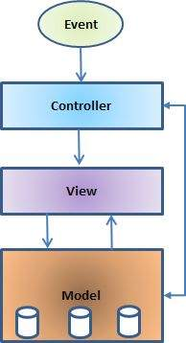
Introduction
MVC Architecture
Model − The lowest level of the pattern which is responsible for maintaining data.
View − This is responsible for displaying all or a portion of the data to the user.
Controller − Software Code that controls the interactions between the Model and View.

Slide 13
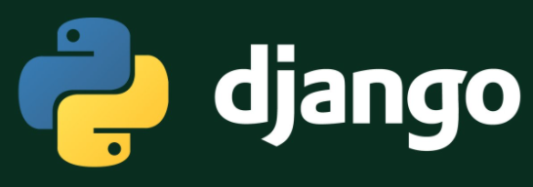
Introduction
Unit – I

Slide 14
Introduction
What is Django?
It is a high-level Python web framework that encourages rapid development and clean, pragmatic design.
Django makes it easier to build better web apps quickly and with less code.
It is written in 100% pure Python code. so you'll need to install Python on your system.

Slide 15
Introduction
Why Django Framework?
It’s very easy to switch database in Django framework.
It has built-in admin interface which makes easy to work with it.
Django is fully functional framework that requires nothing else.
It has thousands of additional packages available.
It is very scalable.

Slide 16
MVT Architecture
Django is based on MVT architecture.
Model
View
Template
MVT is a software design pattern for developing a web application.

Slide 17
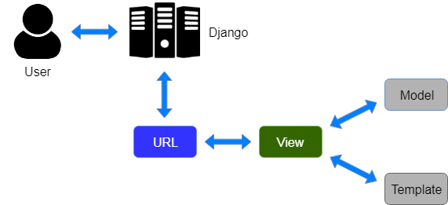
MVT Architecture

Slide 18
MVT Architecture
Model:
Just like the Model in MVC, here as well it has the same functionality of providing the interface for the data stored in the database.
View:
In Django, Views act as a link between the Model data and the Templates.

Slide 19
MVT Architecture
Template
Just like View in MVC, Django uses templates in its framework.
Templates are responsible for the entire User Interface completely.
It handles all the static parts of the webpage along with the HTML, which the users visiting the webpage will perceive.

Slide 20
Control Flow of MVT
The user sends a URL request for a resource to Django.
Django framework then searches for the URL resource.
If the URL path links up to a View, then that particular View is called.
The View will then interact with the Model and retrieve the appropriate data from the database.
The View then renders back an appropriate template along with the retrieved data to the user.

Slide 21
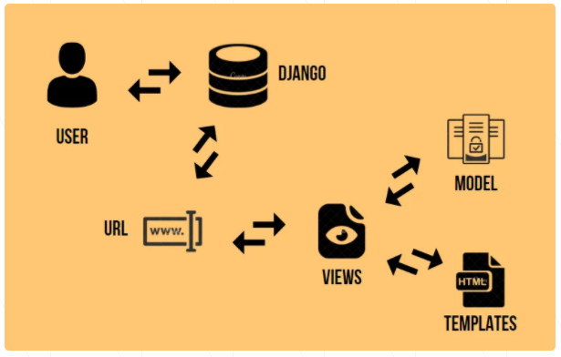
Control Flow of MVT

Slide 22
Features of Django
Rapid Development
Secure
Scalable
Fully loaded
Versatile
Open Source

Slide 23
Features of Django
Rapid Development
Django was designed with the intention to make a framework which takes less time to build web application.
The project implementation phase is a very time taken but Django creates it rapidly.
Secure
Django takes security seriously and helps developers to avoid many common security mistakes, such as SQL injection, cross-site scripting, cross-site request forgery etc.
Its user authentication system provides a secure way to manage user accounts and passwords.

Slide 24
Features of Django
Scalable
Django is scalable in nature and has ability to quickly and flexibly switch from small to large scale application project.
Fully loaded
Django includes various helping task modules and libraries which can be used to handle common Web development tasks.
Django takes care of user authentication, content administration, site maps, RSS feeds etc.

Slide 25
Features of Django
Versatile
Django is versatile in nature which allows it to build applications for different-different domains.
Now a days, Companies are using Django to build various types of applications like: content management systems, social networks sites or scientific computing platforms etc.
Open Source
Django is an open source web application framework.
It is publicly available without cost.
It can be downloaded with source code from the public repository. Open source reduces the total cost of the application development.

Slide 26
Install Django
What is pip?
Python Package Index(pip)
It is a package manager for Python and is included by default with the Python installer
It helps to install and uninstall Python packages

Slide 27
Install Django
Setting up a virtual environment
VirtualEnv helps you create a Local Environment(not System wide) Specific to the Project you are working upon.
If you are start working on Multiple projects, your projects would have different Dependencies (e.g different Django versions) hence you would need a different virtual Environment for each Project. VirtualEnv does this for you.

Slide 28
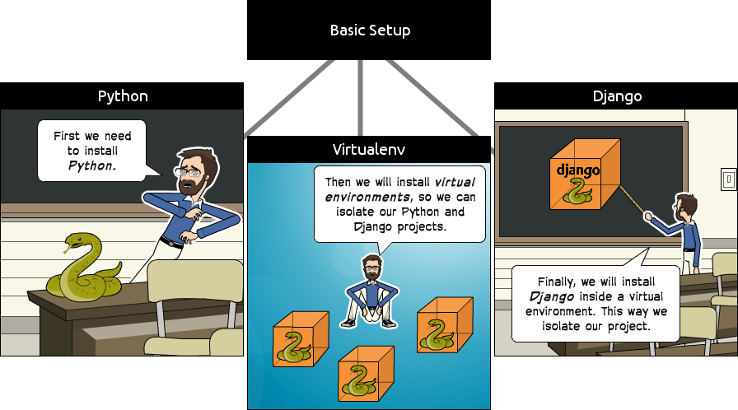
Install Django

Slide 29
Django Environment
Step 1: Install Python
Step 2: Install Virtual Environment
Step 3: Install Django
Step 4: Database Setup
Step 5 : Web Server

Slide 30
Install Django
python --version
pip --version
pip install virtualenv
pip install Django

Slide 31
Django Project
Command to Create a Project
django-admin startproject projectname

Slide 32
Django Project Structure
hello_world/
manage.py
hello_world/
__init__.py
settings.py
asgi.py
urls.py
wsgi.py

Slide 33
Django Project Structure
manage.py
This file is used basically as a command-line utility and for deploying, debugging, or running our web application.
This file contains code for runserver, or makemigrations or migrations, etc. that we use in the shell.
runserver | : | This command is used to run the server for our web application.
Migration | : | This is used for applying the changes done to our models into the database. if we make any changes to our database then we use migrate command. This is used the first time we create a database.
Makemigration | : | This is done to apply new migrations that have been carried out due to the changes in the database.

Slide 34
Django Project Structure
_init_.py
This file remains empty and is present their only to tell that this particular directory(in this case django_project) is a package.
Settings.py
This file is present for adding all the applications and the middleware application present.
Also, it has information about templates and databases.
Overall, this is the main file of our Django web application.

Slide 35
Django Project Structure
urls.py
This file handles all the URLs of our web application.
This file has the lists of all the endpoints that will have for our website.
What is Web Endpoint?
A web service endpoint is a web address or URL where your service can be accessed by a client application.

Slide 36
Django Project Structure
wsgi.py(Synchronous server)
WSGI, short for Web Server Gateway Interface.
It is a specification that describes how a web server communicates with web applications, and how web applications can be chained together to process one request.
It is used for deploying our applications on to servers like Apache etc.

Slide 37
Django Project Structure
Limitations wsgi.py(Synchronous server)
WSGI compatible servers are synchronous
This means it blocks each request until a response arrives from the application.
Blocking requests prevent additional requests from being processed
WSGI implementations (which are multi-threaded) create a thread for each request

Slide 38
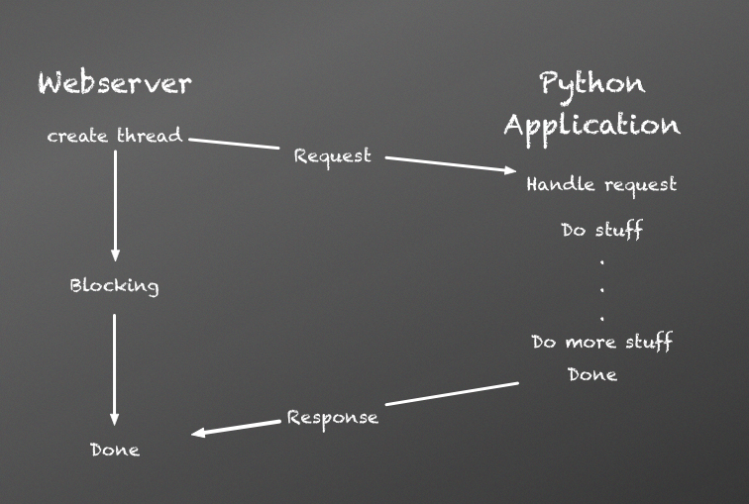
Django Project Structure
Limitations wsgi.py(Synchronous server)

Slide 39
Django Project Structure
asgi.py
ASGI, or the Asynchronous Server Gateway Interface
It is structured as a single, asynchronous callable
It is available in the newer versions of Django.
ASGI can be considered as a succeeder interface to the WSGI.
It work similar to WSGI
It gives better freedom in Django development.
This not only allows multiple incoming events and outgoing events for each application, but also allows for a background coroutine. so the application can do other things (such as listening for events on an external trigger).

Slide 40
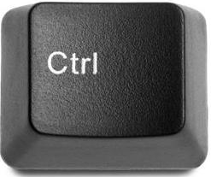
Django Project
Starting a Server
python manage.py runserver
Stopping a Server
Press +
Press Ctrl + Break Button

Slide 41
Django Project
Migration
Python manage.py migrate
Starting an Application
python manage.py startapp Application name

Slide 42
Django Project
View.py
from django.http import HttpResponse
def sayDemo(request):
return HttpResponse("My First Django Program")

Slide 43
Django Project
Setting.py
Under Installed Apps function
Mention the appname

Slide 44
Django Project
urls.py
path(‘name/', view function name),
path(‘Display/', sayDemo),

Slide 45
Django Project
Creating user
Stop the Server
python manage.py createsuperuser
User name:
Email:
Password:
Password(again):

Slide 46
Introduction
Create the Project
Migrate it
Create app
Copy the URL

Slide 47
View Function
A view is a place where we put our business logic of the application.
The view is a python function which is used to perform some business logic and return a response to the user.
This response can be the HTML contents of a Web page, or a redirect, or a 404 error.
All the view function are created inside the views.py file of the Django app.

Slide 48
Creating Simple View
Simple View
create a simple view in myapp to say "welcome to my app!“
from django.http import HttpResponse
def hello(request):
return HttpResponse("<h1>welcome to my app !</h1>")

Slide 49
Django- Template
Django provides a convenient way to generate dynamic HTML pages by using its template system.
Django makes it possible to separate python and HTML
The python goes in views
HTML goes in templates.
To link the two, Django relies on the render function and the Django Template Language(DTL).

Slide 50
Django Template Language (DTL)
Django template uses its own syntax to deal with variable, tags, expressions etc.
A template is rendered with a context which is used to get value at a web page.

Slide 51
Django Template Language (DTL)
Variable
Variables associated with a context can be accessed by {{}} (double curly braces)
My name is {{name}}.
My name is rahul

Slide 52
Django Template Language (DTL)
Tags
In a template, Tags provide arbitrary logic in the rendering process.
A tag can output content, serve as a control structure
Tags are surrounded by {% %} braces

Slide 53
The Render Function
This function takes three parameters
Request
The path to the template
Dictionary of parameters
def hello(request):
return render(request,’home.html’,{‘name’:’sam’})

Slide 54
The Render Function
Request
The initial request.
The path to the template
This is the path relative to the TEMPLATE_DIRS option in the project settings.py variables.
Dictionary of parameters
A dictionary that contains all variables needed in the template. This variable can be created or you can use locals() to pass all local variable declared in the view.

Slide 55
Django Template Configuration
To configure the template system, we have to provide some entries in settings.py file.
TEMPLATES = [
{
'BACKEND': 'django.template.backends.django.DjangoTemplates',
'DIRS': [os.path.join(BASE_DIR,'templates')],
'APP_DIRS': True,
'OPTIONS': {
'context_processors': [
'django.template.context_processors.debug',
'django.template.context_processors.request',
'django.contrib.auth.context_processors.auth',
'django.contrib.messages.context_processors.messages',
],
},
},
]

Slide 56
Django Template Creation
Step 1: create a directory templates inside the project app
Step 2: After that create a template index.html inside the created folder.
Step 3: Create HTML coding's in the index.html
<!DOCTYPE html>
<html lang="en">
<head>
<meta charset="UTF-8">
<title>Index</title>
</head>
<body>
<h2>Welcome to Django!!!</h2>
</body>
</html>

Slide 57
Django URL Mapping
Django is a web application framework.
It gets user requests by URL locater and responds back.
To handle URL, django.urls module is used by the framework.
urls.py
from django.contrib import admin
from django.urls import path
urlpatterns = [
path('admin/', admin.site.urls),
]

Slide 58
Introduction
xcxcxcxcx

Slide 59
Introduction
xcxcxcxcx

Slide 60
Introduction
xcxcxcxcx

Slide 61
Introduction
xcxcxcxcx

Slide 62
Introduction
xcxcxcxcx

Slide 63
Introduction
xcxcxcxcx

Slide 64
Introduction
xcxcxcxcx

Slide 65
Introduction
xcxcxcxcx

Slide 66
Introduction
xcxcxcxcx

Slide 67
Introduction
xcxcxcxcx

Slide 68
Introduction
xcxcxcxcx

Slide 69
Introduction
xcxcxcxcx

Slide 70
Introduction
xcxcxcxcx

Slide 71
Introduction
xcxcxcxcx

Slide 72
Introduction
xcxcxcxcx

Slide 73
Introduction
xcxcxcxcx

Slide 74
Introduction
xcxcxcxcx

Slide 75
Introduction
xcxcxcxcx

Slide 76
Introduction
xcxcxcxcx

Slide 77
Introduction
xcxcxcxcx

Slide 78
Introduction
xcxcxcxcx

Slide 79
Introduction
xcxcxcxcx

Slide 80
References
https://www.tutorialspoint.com/django/django_basics.htm Date : 21-12-2020
https://www.javatpoint.com/django-tutorial Date : 21-12-2020
https://www.fullstackpython.com/django.html Date : 22-12-2020
https://simpleisbetterthancomplex.com/series/2017/09/04/a-complete-beginners-guide-to-django-part-1.html Date : 26-12-2020

Slide 81
THANK YOU

